Slide 1

FRISKY IMAGE The Android Library Version 1.0
Final Year Project
Kalinga Institute Of Industrial Technology
Submitted By-
Dwijraj Bhattyacharyya – 1405214
Debotosh Sarkar – 1405212
Harshit Kumar Gupata - 1405216

Slide 2

Contents :
Introduction
Overall Description
Maven And jcenter
Requirements
System Features
Product Scope
Readme (a bit part of code)
Use case Diagram
Class Diagram
Activity Diagram
Sequence Diagram
Apache License
Future Scope

Slide 3
INTRODUCTION
The purpose of this product is to present a Android library .Android developer can use it at the time of their development process. This presentation will explain the purpose and features of the system, the interfaces of the system, what the system will do, the constraints under which it must operate and how the system will react to external stimuli.

Slide 4
Overall Description
This product is an android library that android developers can use while developing android applications so that they are freed from the task of writing too many boiler plate codes for implementing various animations.
This library will have various functions that the developers would call which would help them improvise their UI/UX .

Slide 5
MAVEN AND JCENTER
The Android Studio build system supports remote Maven dependencies. Maven is a popular software project management tool that helps organize project dependencies using repositories.
jcenter is the new default repository used with Android's gradle plugin. jcenter is a Java repository in Bintray, which is the largest repo in the world for Java and Android OSS libraries, packages and components

Slide 6
REQUIREMENTS
User Interfaces
Since this is an android library it doesn’t have it’s own UI .This is use to improve UI of android
applications.
Software Interfaces
The connections between this product and other specific software components are: Bintray database for uploading into gradle and maven repositories, android operating system, android studio.
Communications Interfaces
This project will communicate with other android applications via various functions calls available
in it.

Slide 7
SYSTEM FEATURES
This template illustrates organising the functional requirements for the product by system features, the major services provided by the product.
Android version having API level 17 and above.
Android OS 4.0 and above.
Works on android tablets , phones.

Slide 8
PRODUCT SCOPE
This library will have various functions that the developers would call which would help them improvise their UI/UX . The library functions contains boiler plate codes that one needs to write for performing various animations and the code is tested so that the developers need not worry about writing and testing them and developers could also customize.

Slide 9
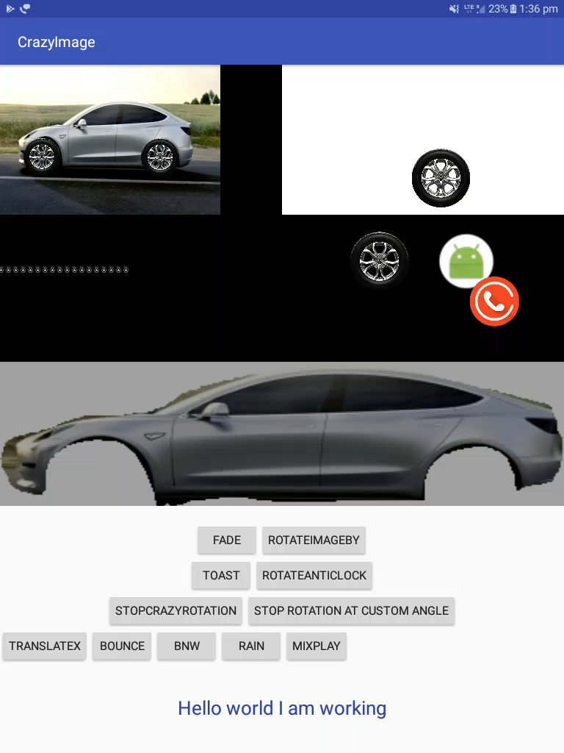
README

Slide 10
README
Here's the java code to run car using Various APIs
FriskyTanslations Wheel1=new FriskyTanslations(MainActivity.this,R.id.Image1); FriskyTanslations Wheel2=new FriskyTanslations(MainActivity.this,R.id.Image2); Wheel1.StartRotationClockWise(); Wheel2.StartRotationClockWise(); FriskyTanslations Car=new FriskyTanslations(MainActivity.this,R.id.car); Car.MoveXBy(-140,3000); Wheel1.MoveXBy(-140,3000,true); Wheel2.MoveXBy(-140,3000,true);

Slide 11
README
Colliding Animation!
The colliding animation provides 2 default colliding animations namely FriskyBounce,CrazyBounce which have more Subdivision's as visible on the video each animation can be done in just a few lines exmapleFriskyBounce friskyBounce1=new FriskyBounce(MainActivity.this,R.id.RootId123,R.id.ID1234ID); FriskyBounce friskyBounce1=new FriskyBounce(MainActivity.this,R.id.RootId123,R.id.ID1234ID); FriskyBounce friskyBounce2=new FriskyBounce(MainActivity.this,R.id.RootId123,R.id.ID1235ID); FriskyBounce friskyBounce3=new FriskyBounce(MainActivity.this,R.id.RootId123,R.id.ID1236ID); friskyBounce1.StartCrazyBounce1(3000); friskyBounce2.StartCrazyBounce2(3000); friskyBounce3.StartBounce(5000,3000); FriskyBounce friskyBounce=new FriskyBounce(MainActivity.this,R.id.RootId123,R.id.ID123ID); friskyBounce.StartCrazyBounce3(3000); FriskyBounce friskyBounce=new FriskyBounce(MainActivity.this,R.id.RootId123,R.id.ID123ID); friskyBounce.StartCrazyBounce3(3000);

Slide 12
README
Rain animation
Here's the code to integrate rain
new FriskyRain().StartRain(R.drawable.rain_drop,R.id.Root1235,-10,MainActivity.this);
Just send the raindrop's image the layout on which the rain animation is to be carried out and the context and you are good to go

Slide 13
README
FriskyShimmer
Use shimmering View to give your view's a shiny effect in just 2 line's exmaple For Textview XML<dwijraj.FriskyView.FriskyFriskyShimmerTextView android:layout_width="match_parent" android:text="Hello world I am working" android:textSize="23sp" android:gravity="center" android:id="@+id/FriskyShimmer" android:textColor="@color/colorPrimaryDark" android:layout_height="120dp" />
Java code
shimmerTextView=(FriskyFriskyShimmerTextView) findViewById(R.id.FriskyShimmer); FriskyShimmer shimmer=new FriskyShimmer(); shimmer.setDuration(5000); shimmer.start(shimmerTextView);

Slide 14
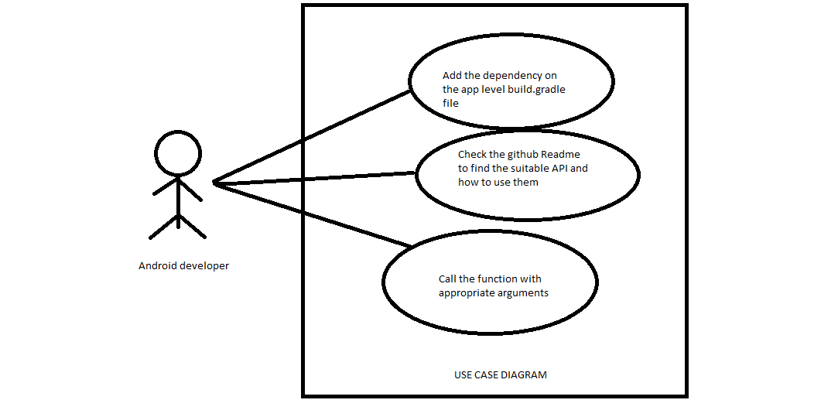
USE CASE DIAGRAM

Slide 15
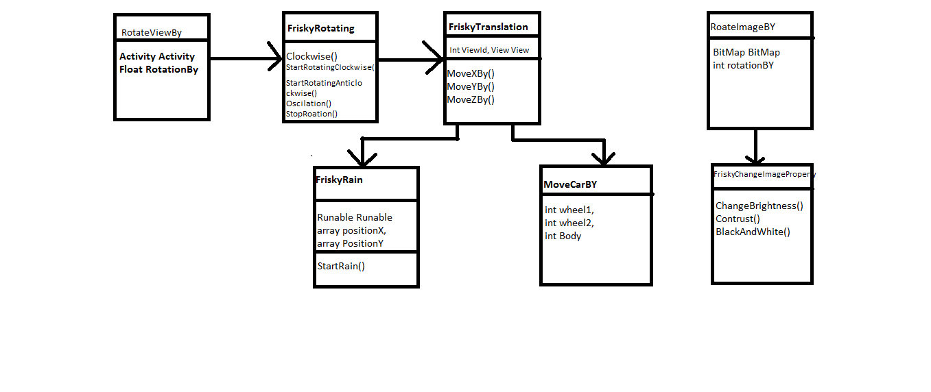
CLASS DIAGRAM

Slide 16
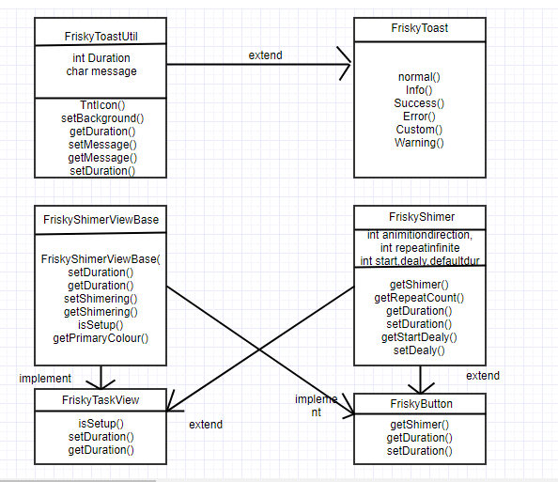
CLASS DIAGRAM

Slide 17
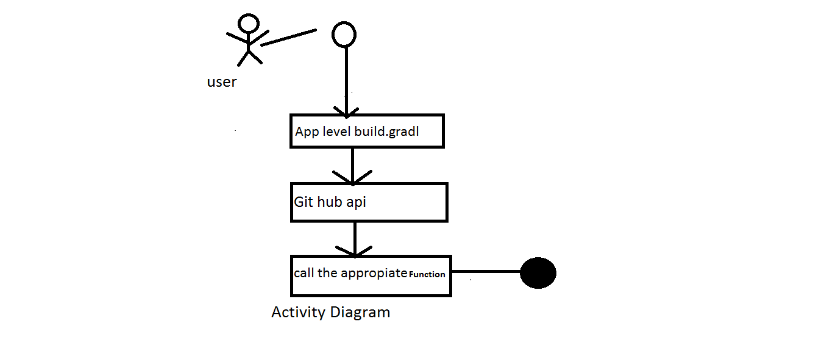
ACTIVITY DIAGRAM

Slide 18
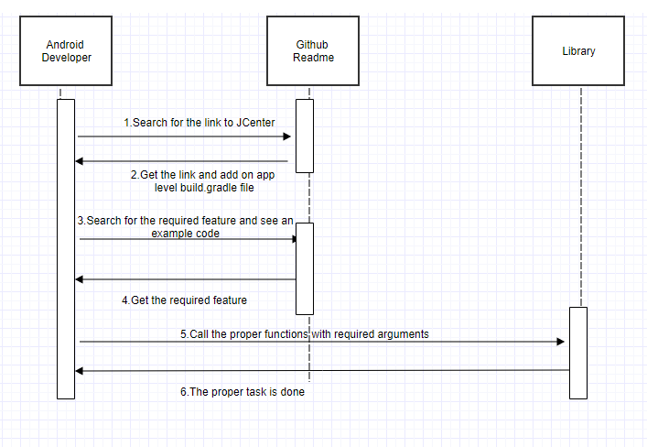
SEQUENCE DIAGRAM

Slide 19
APACHE LISENCE
http://www.apache.org/licenses/LICENSE-2.0
A permissive license whose main conditions require preservation of copyright and license notices. Contributors provide an express grant of patent rights. Licensed works, modifications, and larger works may be distributed under different terms and without source code.
Copyright 2017 Dwijraj Bhattacharyya

Slide 20
FUTURE SCOPE
Integrating more features into the library so that developer have more options to choose from .

Slide 21
THANK YOU

